Slide 1

Duck Quest
Michael, Mikayla, Tyler, and Ryan

Slide 2
Game Intro
Duck Quest
Goal: Defeat monsters, obtain treasures, get stronger
Story: Your airship crashes on an island after a storm and you awaken in a strange house. It appears the villagers have saved you and you must help them to help you to leave the island.

Slide 3

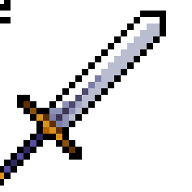
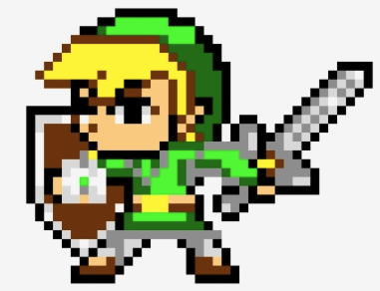

Our Team: Who We Are
Michael
Mikayla Winant - Enemy Feature
Tyler
Ryan

Slide 4
Storyboard

Slide 5
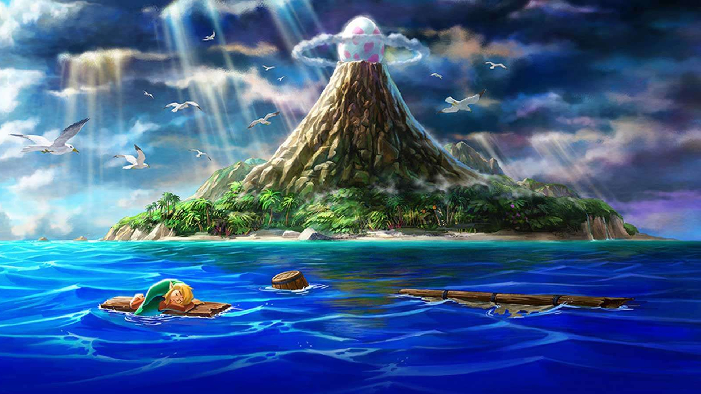
Shipwreck on Beach
Trouble ahead! While piloting your airship, a storm approaches and you crash on an island! Upon crashing, your airship is completely destroyed and you are knocked out…

Slide 6

Wake up in Town
You mysteriously wake up in a house. This house is in a small town just north of the beach. You decide to eventually go back to the beach to check on your airship, filled with a sense of adventure.

Slide 7


Meet Waddles, Collect Sword
You head back to the beach to check the state of your airship. You meet Waddles, who has come along your sword. He offers your sword back to get your debris off his beach. Your ship is in rough condition, but he informs you there is a mechanic. He went missing near the forest.

Slide 8
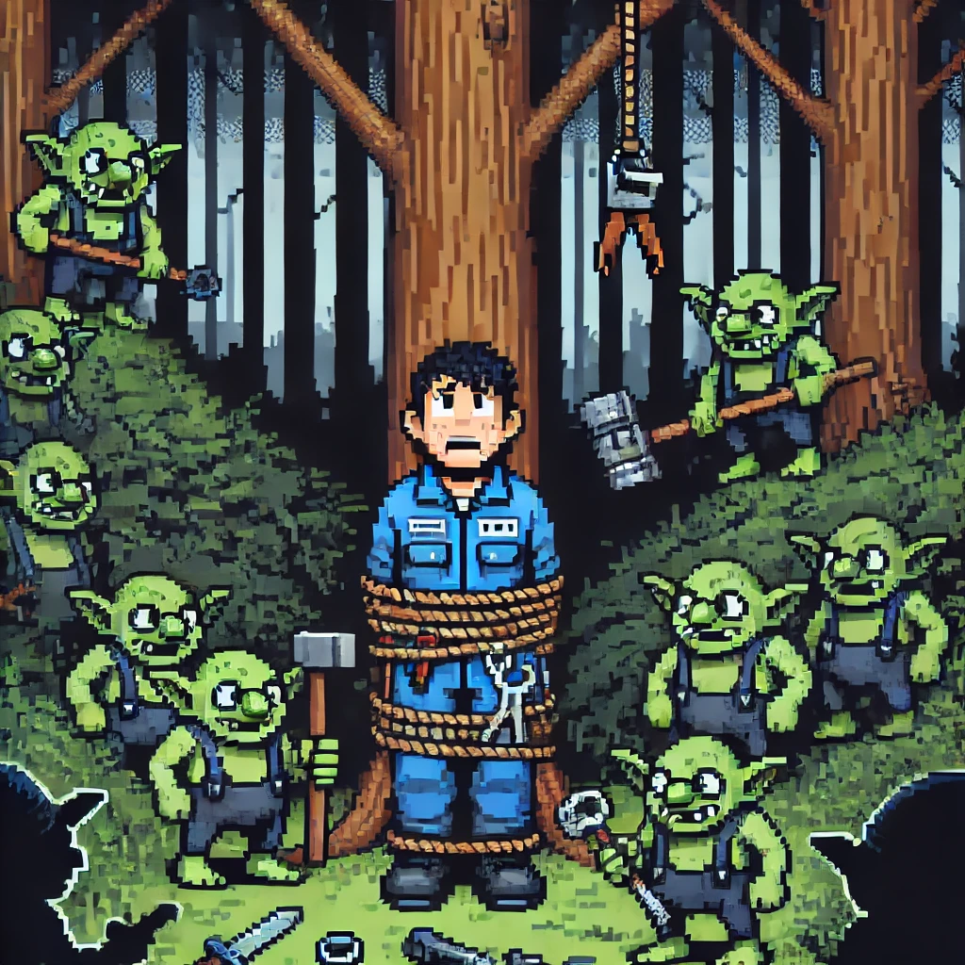
Rescue Mechanic
You step into the dark forest and after searching, you find the mechanic. However, he is held captive by forest goblins. The sword will help. You free him and in return he agrees to help you repair your ship while you gather supplies needed for the repairs.

Slide 9
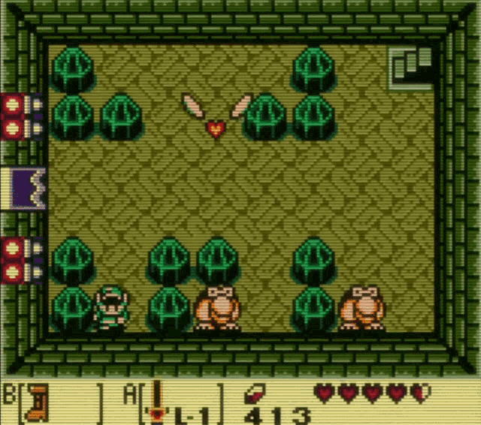
Dungeon Exploration
The player must enter into dungeons to retrieve the supplies
Upon entering, they must defeat enemies and solve puzzles to progress through the dungeon
However, there are inaccessible areas…
If only there were items you could find that would help you progress…

Slide 10
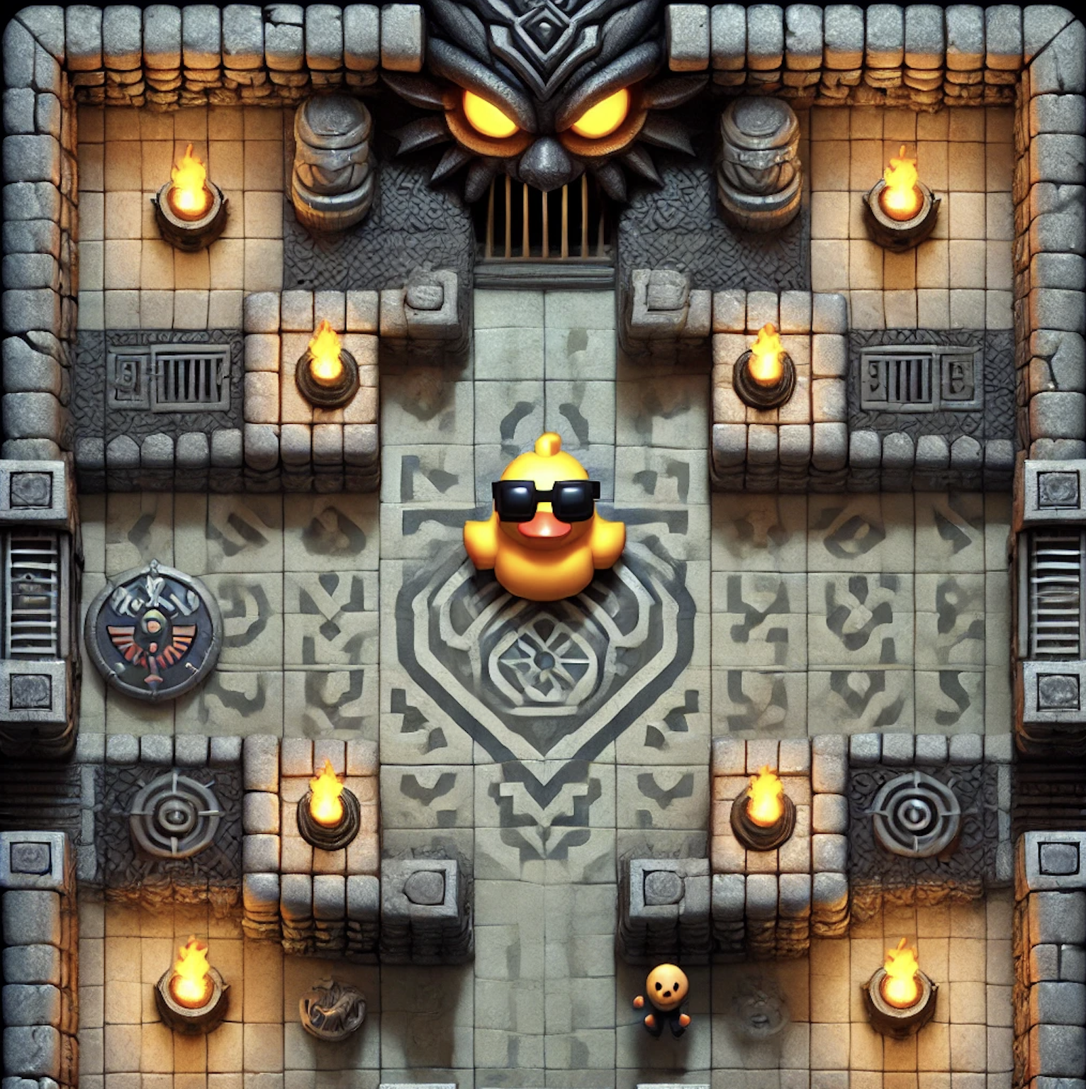
Boss Fight
You enter the final room to gather the remaining supplies needed to fix your ship. The only thing standing between you and freedom is the boss.
Waddles offers tips to defeat the boss in the corner, although by his tone you can’t quite tell if he cares if you live or die…
Mikayla

Slide 11
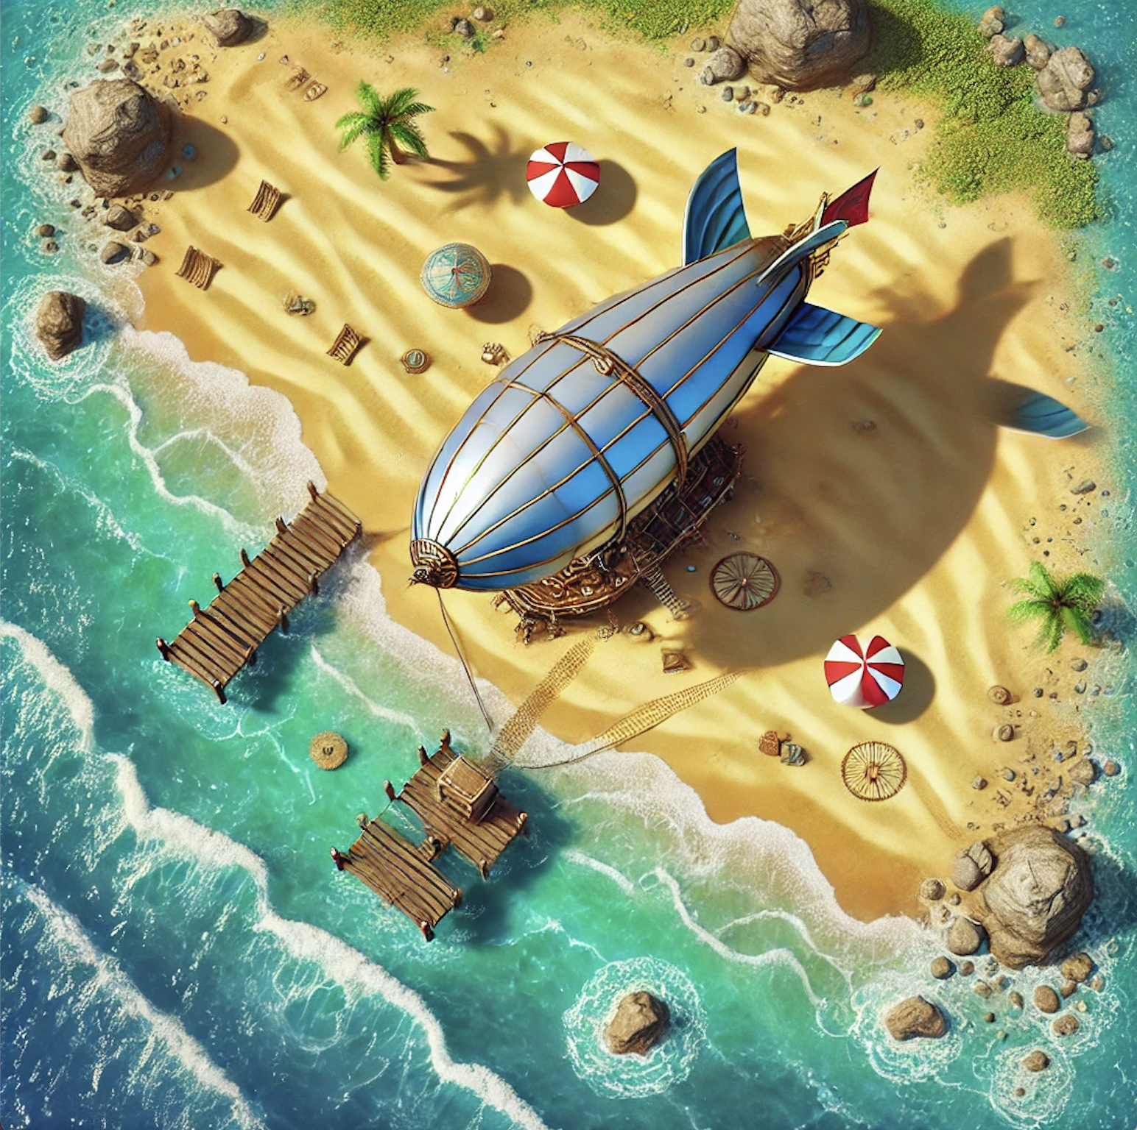
Win! The End (Not Really)
You’ve successfully defeated the boss and have all of the supplies needed to fix your ship!
You find out the next closest land mass is hundreds of miles away. That storm took you further off course than you thought.
If only there was a way get more fuel…
Mikayla

Slide 12
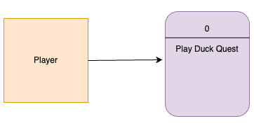
Level 0 Data Flow Diagram (Context Diagram)

Slide 13
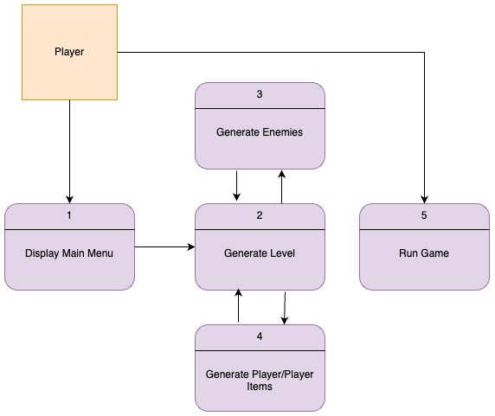
Level 1 Data Flow Diagram (Diagram 0)

Slide 14
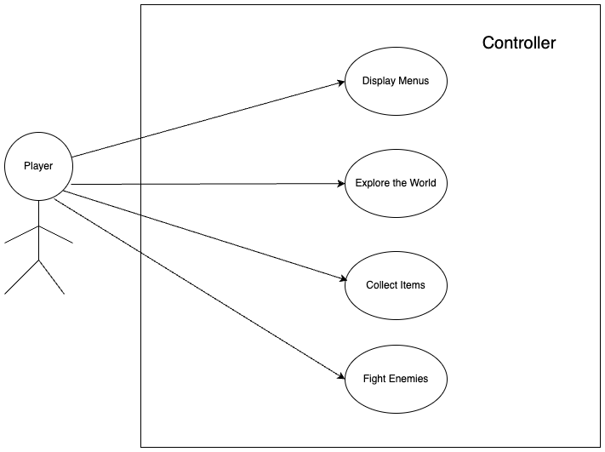
Global Use Case Walkthrough

Slide 15
Player Features
Tyler

Slide 16
Feature Introduction
Player movement, actions, and abilities
The player uses a weapon to make an attack
Priority 1
Medium complexity
To start with, there will be basic sword attacks and bow attacks
As the player progresses, they will find better weapons
This will allow for unique abilities that modify the normal behavior of the weapon
Will have to check for enemy/world collisions and modify objects as necessary
Tyler

Slide 17
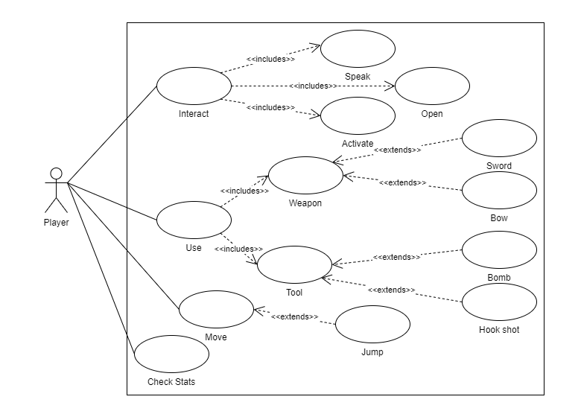
Use Case Diagram
Tyler

Slide 18
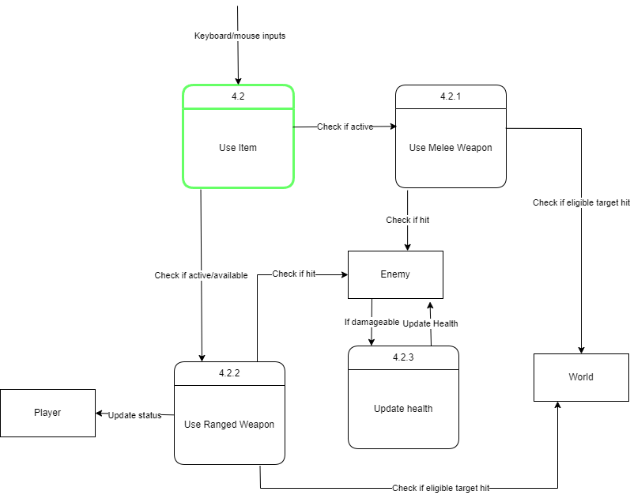
Level 2 Data Flow Diagram: Use Item
Tyler

Slide 19
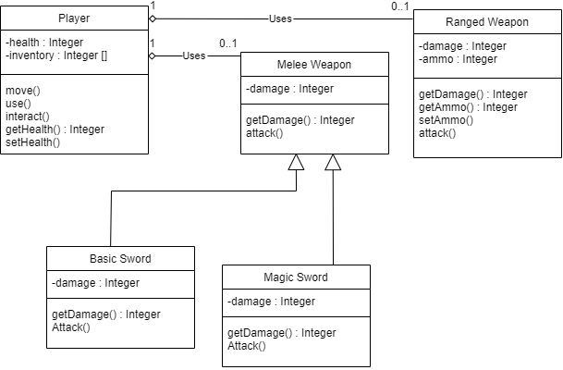
Class Diagram
Tyler

Slide 20
Generate Level/World Feature

Slide 21
Feature introduction
This is the world in which the player will explore, including the beach, house, dungeons, and town
Priority 1
Medium Complexity
All of the entrances will be held together by different flags
Everytime a player enters an entrance or starts the game the engine will read that flag
This will determine the spawn location of both the player and other entities in a room
Michael

Slide 22
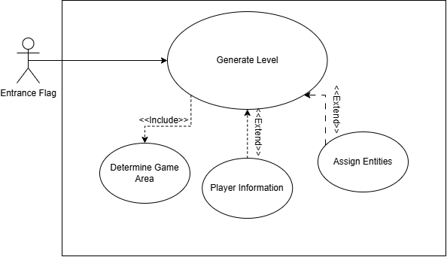
Use Case Diagram
Michael

Slide 23
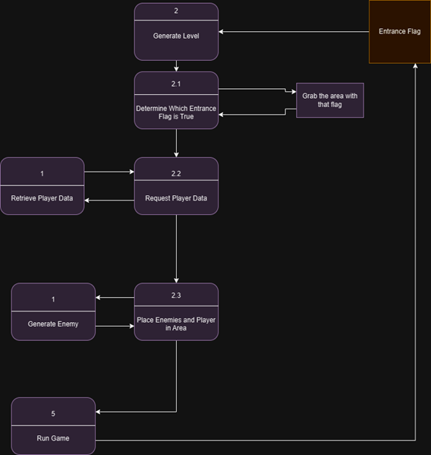
Data Flow Diagram
Michael

Slide 24
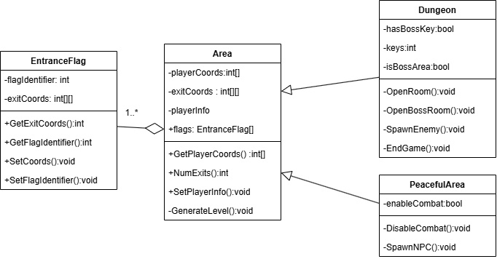
Class Diagram
Michael

Slide 25
Enemy Feature

Slide 26
Feature Introduction
Player defeats enemies to get through areas of the dungeon, including a boss
Priority 2
Medium Complexity
Different Enemy Types, Weapons, and Attacks
Enemy Functions must interact with Player Functions
Mikayla

Slide 27
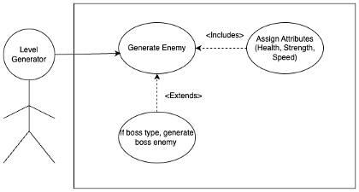
Use Case Diagram
Mikayla

Slide 28
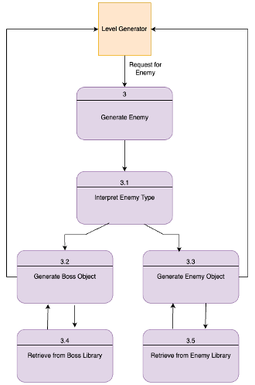
Level 2 Data Flow Diagram: Spawn Enemy
Mikayla

Slide 29
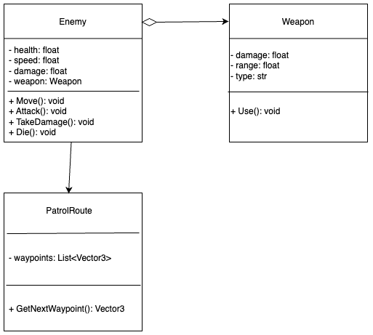
Class Diagram
Mikayla

Slide 30
User Interface/Sound Feature

Slide 31
Feature Introduction
Features:
User Interface
Sound
Player enters game with a few options to select from. They can also pause to see in-game options/inventory. Great sound design also makes the game more engaging and entertaining.
Priority: 3
Not necessary but crucial to tone of the game and player interaction
Easier Complexity
Ryan

Slide 32
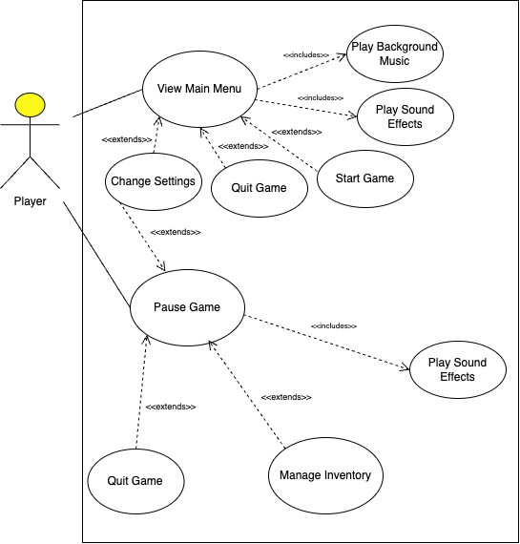
Use Case Diagram
Ryan

Slide 33
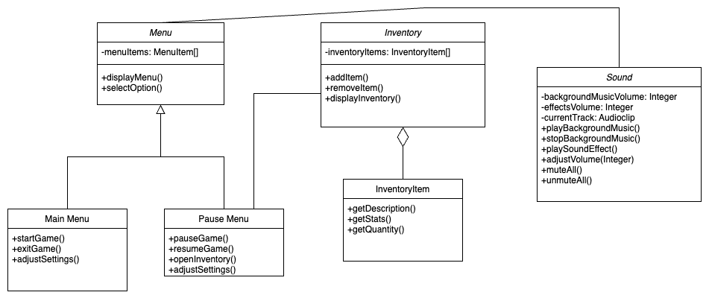
Class Diagram
Ryan

